Slide 1




Case Studies in AI for Business Prof. Dr. Ahmed Elseddawy
Done by : Ahmed Samir EL- Sayed Mohamed
ID: 23225151

Slide 2
Predictive Maintenance Using AI in Manufacturing Plants

Slide 3
Business Understanding

Slide 4
Industry 4.0 and Digital Transformation in Manufacturing
The manufacturing sector is experiencing major transformation driven by Industry 4.0 technologies.
-Key enabling technologies include:
1)Internet of Things (IoT)
2)Cloud Computing
3)Big Data Analytics
4)Artificial Intelligence
5)Cyber-Physical Systems.
These technologies enable smart manufacturing environments where machines, systems, and data are interconnected.
Digital technologies improve:
1)operational efficiency
2)production visibility
3)decision-making capabilities.

Slide 5
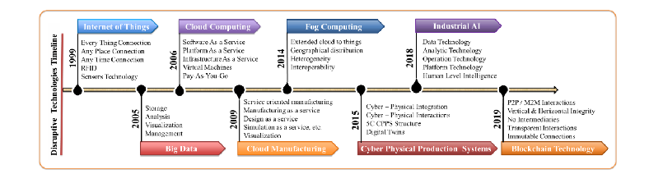
Industry 4.0 and Digital Transformation in Manufacturing

Slide 6
Industry Characteristics/Electronics Manufacturing Industry
The electronics manufacturing sector has several operational characteristics:
1)High Automation
Extensive use of robotics and automated production lines.
2)High Quality Requirements
Strict quality standards and testing processes.
3)Rapid Innovation Cycles
Continuous product innovation and short product lifecycles.
4)Global Competition
Companies compete globally on cost, efficiency, and delivery reliability.

Slide 7
Organization Context/Siemens Amberg Electronics Plant
The study focuses on Siemens AG Amberg Electronics Plant, a highly automated manufacturing facility.
Siemens operates globally in:
1)Industrial technology
2)Infrastructure
3)Transportation
4)Healthcare.
In 2025, Siemens reported revenue of approximately €87.3 billion.
The Amberg plant produces industrial automation and electronic components using advanced manufacturing technologies.

Slide 8
Problem Analysis

Slide 9
Maintenance Evolution
Maintenance strategies in manufacturing have evolved through several stages:
1)Reactive Maintenance
Equipment repaired only after failure occurs.
Leads to high downtime and costly repairs.
2)Preventive Maintenance
Maintenance performed on scheduled intervals.
Often results in replacing parts before their actual failure.
3)Predictive Maintenance
Uses data analytics and AI to predict failures before they occur.
Enables proactive maintenance planning.
4)Prescriptive Maintenance
AI recommends optimal maintenance actions automatically.

Slide 10
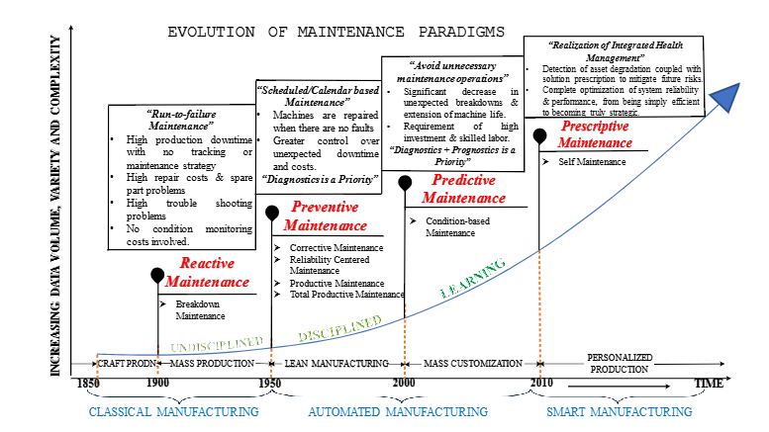
Maintenance Evolution

Slide 11
Core Business Problem
Unplanned Equipment Downtime
The Siemens Amberg plant experienced significant operational challenges:
Approximately 85 hours of unplanned downtime per month.
Each hour of downtime costs around €40,000 in lost production output.
Equipment failures often occurred without early warning signs.
Troubleshooting automated equipment required significant time and expertise.
This downtime significantly affected production efficiency and revenue generation.

Slide 12
Limitations of Traditional Systems
Limitations of Traditional Maintenance Systems
1)SCADA Monitoring Limitations
Detects abnormal parameters only after threshold values are exceeded.
2)Manual Monitoring Constraints
Operators cannot continuously analyze large volumes of sensor data.
3)Data Silos Across Systems
Different operational data sources are disconnected
This lack of integration prevents holistic decision-making.

Slide 13
Limitations of Traditional Systems
System | Data type | Limitation
CMMS | Maintenance history and work orders | No real-time machine data
MES | Production schedules | No maintenance context
History | Time-Series sensor data | No failure outcome labels
ERP | Parts inventory and costs | No equipment condition data

Slide 14
Operational and Financial Impact
Maintenance inefficiencies created major operational gaps:
Operational Gap
Overall Equipment Effectiveness (OEE): 78%
Industry benchmark: 85%
Strategic Gap
On-time delivery rate: 92%
Target delivery reliability: 98%

Slide 15
Operational and Financial Impact
Financial Impact
€40.8M annual losses from downtime
€15.8M maintenance labor cost
€4.1M spare parts inventory cost
€2.1M quality scrap and rework cost
Total estimated financial impact: €21.54 million annually

Slide 16
AI Solution Overview

Slide 17
AI Solution for Predictive Maintenance
Siemens implemented a multi-layer AI architecture for predictive maintenance at the Amberg manufacturing plant.
The system integrates:
Industrial IoT sensors Cloud computing infrastructure Machine learning models ERP system integration

Slide 18
AI Technologies Used
Core AI Technologies
Failure Mode Classification Random Forest and Neural Networks identify machine failure types.
Prescriptive Maintenance Optimization Reinforcement learning recommends optimal maintenance timing.
Remaining Useful Life Prediction LSTM networks predict time-to-failure of equipment components.

Slide 19
Business Functions Impacted
Maintenance
Predictive work orders
35% productivity improvement
Production
Reliable production schedules 15% improvement in schedule reliability
Supply Chain
Optimized spare parts inventory 20% inventory reduction
Finance
Predictive budgeting 20% reduction in maintenance costs

Slide 20
AI Predictive Maintenance Process
AI-Based Predictive Maintenance Process
Continuous monitoring using IoT sensors Real-time anomaly detection Failure prediction using machine learning Risk prioritization based on production impact Prescriptive maintenance recommendations ERP integration for automated work orders Feedback loop for model retraining

Slide 21
Machine Learning Methods
Machine Learning Methods
Supervised Learning Uses labeled datasets to predict equipment failures.
Unsupervised Learning Identifies hidden patterns in sensor data.
Semi-Supervised Learning Combines labeled and unlabeled data to improve prediction accuracy.

Slide 22
RPA in Predictive Maintenance
Robotic Process Automation (RPA)
RPA automates repetitive tasks across predictive maintenance workflows.
Examples include:
Data aggregation from SAP and MES Checking spare parts availability Automatic work order creation Performance reporting and dashboards Model retraining automation

Slide 23
SDLC Methodology
Software Development Lifecycle
The predictive maintenance system was implemented using an Agile methodology.
Framework used:
Scrum
Key stages:
Data collection Model development Testing and validation Deployment Continuous improvement and retraining

Slide 24
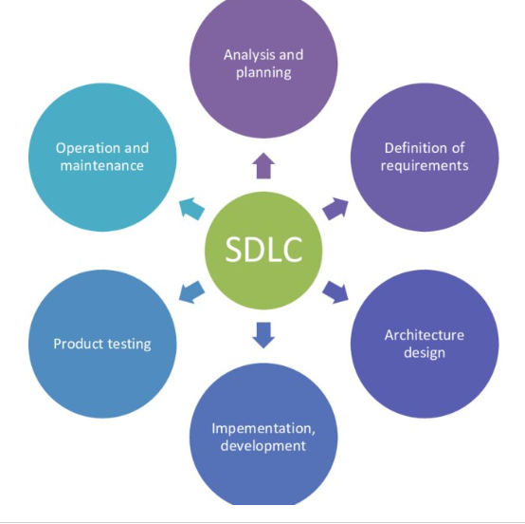
SDLC Methodology

Slide 25
Data Analytics Components

Slide 26
Data Analytics Components
Predictive maintenance relies on multiple types of operational and sensor data. Manufacturing systems generate data from machines, enterprise systems, and sensors. These data sources are integrated to enable predictive analytics and machine learning models.

Slide 27
Types of Data
Data type | Definition | Structure | Systems
Structured data | Data organized in a predefined format such as rows and columns | Highly organized such as tables and datasets | ERP, CMMS and MES
Unstructured data | Data that does not follow fixed format or table structure | Not organized (Text, images, audio and video) | Technician reports, emails and images
Real Time data | Data generated and processed instantly as events occurs | Continuous streaming data | IOT sensors, plc, sensors and Scada system
Historical data | Past stored collected and stored over time | Stored datasets from previous operations | Data warehouses, maintenance history databases

Slide 28
Data Sources
Data Sources | Description | Example Data | System
ERP systems | Enterprise systems that manage business operations such as inventory, production and maintenance | Production orders, spare parts inventory | SAP ERP, Oracle ERP and Odoo ERP
MES (Manufacturing execution system) | Systems used to monitor and control production processes on the factory floor | Execution time, production schedules | Manufacturing execution platform
IOT sensors | Physical sensors installed on machines to collect equipment condition data | Temperature, vibration and pressure | Industrial IOT devices and sensors
Operational transaction data | Records of operational events and task execution outcomes | Task allocation, Task completion | Production databases and operational log

Slide 29
Dataset Description owned
Dataset Used: Industrial Scheduling Dataset
Structured dataset organized in rows and columns. Contains historical operational records. Includes real-time sensor measurements such as temperature and latency.
Data Sources Integrated
IoT sensors measuring machine conditions MES system recording execution time and machine IDs ERP system recording task types and IDs Operational databases recording targets and reallocations

Slide 30
Analytics Technique

Slide 31
Types of analytics
Type of analytics | Main question | Purpose | Example
Descriptive analytics | What Happened? | It’s summarizes historical data | Monthly production data
Diagnostic analytics | Why did it happen? | Identifies root causes | Analysis of delay reasons
Predictive analytics | What will happen? | Forecasts future outcomes | Predict machine failure
Prescriptive analytics | What should we do? | Recommends optimal actions | Best maintenance schedule
Key performance indicators (KPIs) and metrics | N/A | KPIs is the key measure linked to strategic goal while metrics general performance measurement | On time project delivery date while metrics is number of delayed tasks

Slide 32
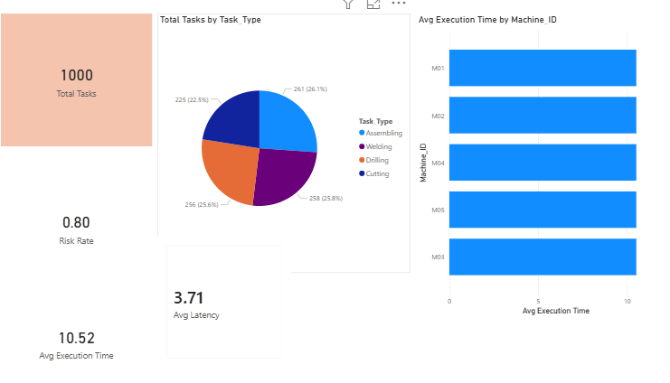
Descriptive analytics
It’s summarized the dataset to understand overall operational performance, system workload and resource utilization for our dataset let’s see the following dashboard

Slide 33
Descriptive analytics
1st Total task: This metrics represent the total number of industrial tasks processed in the system, it’s provides an overview of operational workload and system utilization.
2nd Average execution time by machine ID: Average execution time indicates the typical duration required to complete tasks regarding the machine ID, it is a key performance indicator for evaluating operational efficiency.
3rd Average execution time: Average execution time indicates the typical duration required to complete tasks, it is a key performance indicator for evaluating operational efficiency.
4th Average Latency: Latency measure communication delay within the network, higher latency may negatively impact task execution performance.
5th Total task by task type: This analysis shows how tasks are distributed across different operational categories.

Slide 34
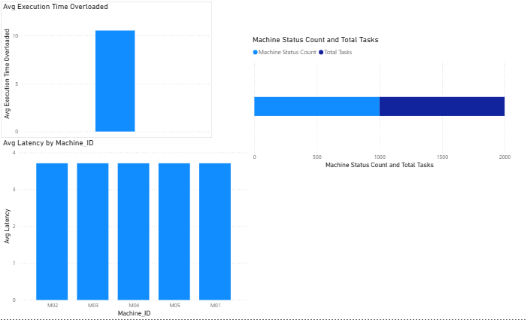
Diagnostic analytics
Diagnostic analytics investigates why certain performance patterns occur, such as delays, overload conditions and efficiency differences.

Slide 35
Diagnostic analytics
1st Average execution time overloaded: This analysis shows the average execution time when machines are overloaded
2nd Average latency by machine ID: This analysis shows the latency level for each machine.
3rd Machine status count and total tasks: This analysis shows machine status if they are idle or active or in maintenance period and total task done in this period.

Slide 36
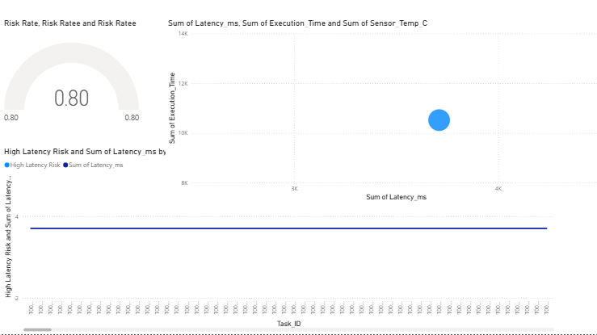
Predictive analysis
predictive analysis uses historical data, machine learning and statistical models to predict future outcomes.

Slide 37
Predictive analysis
1st Risk rate gauge: This analysis shows that the system risk level
2nd Latency vs execution time: This analysis is to identify the relationship between delays and machine performance if latency increase execution time should be increase and this lead to decrease in machine performance
3rd High latency risk line: This analysis indicates task with high latency risk thresholds.

Slide 38
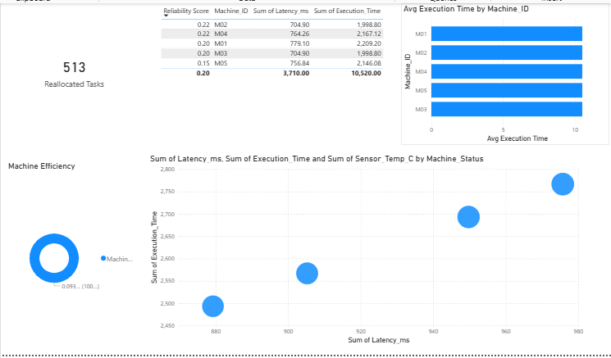
Prescriptive analysis
Prescriptive analysis is the most advanced stage in any analytics it recommends actions to achieve the best outcomes.

Slide 39
Prescriptive analysis
1st Reallocated tasks: This analysis is to shows the number of tasks assigned to different machines.
2nd Reliability score table: This table shows machine ID with reliability score with total latency and execution time to identify most reliable machines for scheduling tasks.
3rd Machine efficiency chart: This analysis to measure machine performance effectiveness.
4th Latency vs execution time: This analysis contains latency with sensor temperature and execution time to identify how machine conditions affect performance.

Slide 40
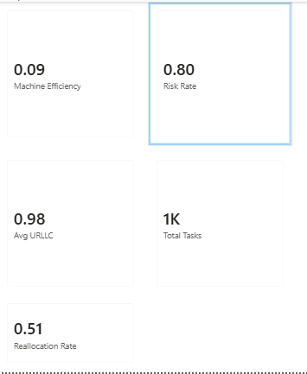
Key performance index (KPI’s)
Key performance index is a metrics used to measure organizational performance against strategic goals.

Slide 41
Key performance index (KPI’s)
1st Machine efficiency: This to measure how effectively machines process tasks.
2nd Risk rate: This to indicates operational risk.
3rd Average URLLC: URLLC stands for ultra-reliable low latency communication in this is used by IoT systems and this to measure communication reliability.
4th Total task: This is to show the executed task in system.
5th Reallocation Rate: This is to show percentage of task assigned to optimize scheduling.

Slide 42
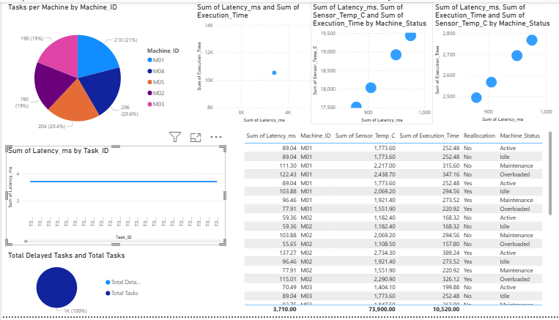
Simple Dashboard
Dashboard is a visual interface that display key business metrics in real time it allows manager and board member to take decision and to monitor performance in high efficiency way.

Slide 43
Simple Dashboard
1st Task per machine: This to show the workload distributed among machines.
2nd Latency vs execution time: This to show machine performance and operational efficiency.
3rd Task latency by task ID: This to show variation across tasks and this is used to identify which tasks cause delays in performance.
4th Data table: This table is for machine ID with Sensor temperature with latency with execution time with reallocation status and machine status this table to show detailed operational data for analysis.

Slide 44
Digital transformation analysis

Slide 45
Changes in business processes and workflows
Before digital transformation the maintenance process was primarily reactive (Run-to-failure) or preventive (Time-based) workflow were linear the machine broke down then work order was created manually then the required technician will be assigned and the missing parts ordered after that the maintenance began all of that will cause unplanned downtime and inefficient resource allocation.

Slide 46
Changes in business processes and workflows
After digital transformation the process becomes proactive and prescriptive AI algorithms analyze real time sensor data to predict failures then the workflow is transformed into a data driven loop IoT sensors and ERP data feed the AI model to do continuous monitoring, the AI model predicts a potential failure with estimated time of occurrence this is what we say prediction and alert, the system automatically creates a work order in the ERP and prioritizes it based on production schedule this is called Automated work order generation, the maintenance is scheduled during planned downtime and required parts are automatically called from inventory (Proactive intervention), after all of that the feedback will be sent to improve AI model to improve its future prediction

Slide 47
Automation of manual or repetitive tasks
The AI solution automates several manual tasks such as:
Data collection replaces manual and periodic equipment checklists with automated sensor for data collection.
Data analysis Automates the analysis of vibration, temperature, and acoustic data which eliminated the need expert to manually interpret the data.
Reporting Automates the generation of maintenances schedules and performance dashboards.
Inventory management Automates the ordering of spare parts by linking predicted failures to ERP inventory.

Slide 48
Impact on organizational culture and decision making
Culture shift Moves the maintenance team from a firefighting culture to a strategic, analytical one the technicians become data interpreters who validate AI prediction shifting their role from reactive repair to proactive care. Decision making: Decisions are no longer based on fixed schedules but on data driven predictions, plant managers can make strategic decisions based on asset health trends rather than reacting to sudden failures.

Slide 49
Customer experience improvements
We have two customer segmentation B2B customer and end consumer
B2B customer Predictable production schedule lead to more reliable lead ties and just on time delivery which increasing customer trust and satisfaction.
End customer Reduced downtime ensures product availability and supply chain stability

Slide 50
Comparison of before and after digital transformation
Feature | Before | After
Maintenance approach | Reactive / Preventive | Predictive / prescriptive
Data usage | Historical and manually collected | Integrated and real time from IoT and ERP
Decision making | Experience based | Data driven
Downtime | Unplanned and costly | Minimized and primarily planned
Workforce role | Firefighters | Strategic planners

Slide 51
ERP integration

Slide 52
ERP SAP modules involved
SAP plant maintenance The core module of managing maintenance activities, work orders and equipment histories. SAP materials management for spare parts inventory management, procurement and supplier. SAP production planning This to align maintenance schedules with production plans SAP finance This to track maintenance costs, analyze ROI and manage budgets.

Slide 53
How AI integrates with ERP systems
The AI platform such as cloud based analytics or an AI module it receives real time data from ERP and from IoT sensors when the AI model generates a prediction it sends a signal back to the ERP to trigger a specific action

Slide 54
Data flow between AI tools and ERP
ERP to AI The AI tool receive historical work order data, equipment specification and spare parts lists from the ERP to train the AI model.
Sensors/IoT to AI Real time vibration, temperature and pressure data to the AI platform.
AI to ERP When a failure is predicted the AI tool creates a notification in the SAP PM module after that generating a work order automatically.
ERP to inventory The work order makes a reservation of the required spare parts in the SAP MM module.
ERP to AI Once the maintenance is completed the work order status is updated in the ERP and this data is become feedback to the AI model for continuous learning and improvement.

Slide 55
Benefits of ERP and AI integration
There are three benefits from the integration of ERP and AI as the following:
End to End automation the integration creates closed loop system from prediction to procurement to repair.
Improved asset management Provides a single source of complete lifecycle of an asset from procurement to real time condition to maintenance history.
Optimized inventory reduces excess inventory of rarely used parts while ensuring high availability of critical spares based on predicted needs.

Slide 56
Challenges in ERP implementation or customization
Data silos ERP systems might have poor data quality or missing fields required for effective AI modeling.
Integration complexity Connecting real time IoT data to older ERP systems requires robust middleware and API management.
Scalability The ERP system must be capable of handling a significantly higher volume of transactions without performance degradation

Slide 57
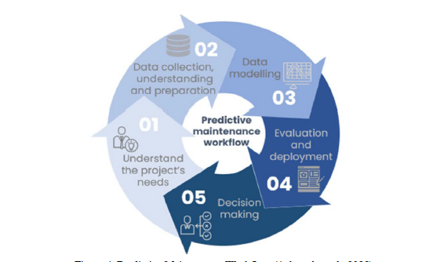
Work flow

Slide 58
Business impact and value creation.

Slide 59
Financial impact
Cost Reduction Significant reduction in unplanned downtime costs, reduction in maintenance labor costs and emergency parts procurement.
Revenue Growth Increased overall equipment effectiveness leads to higher throughput and production capacity.
ROI The ROI is often realized within 6-18 months through a combination of cost avoidance (Downtime) and increased output.

Slide 60
Operational efficiency improvements
Increased OEE A 10-20 % increase in overall equipment effectiveness is a common benchmark for AI driven predictive maintenance. Reduced mean time to repair Because parts and technicians are pre scheduled MTTR drops significantly. Extended asset lifespan Operating equipment only when it is healthy and intervening early prevents catastrophic failures

Slide 61
Strategic advantages gained
Manufacturing as a service High asset reliability allows a company to offer its manufacturing capacity as a service to other businesses. Talent attraction A digitally transformed plant is more attractive to a new generation of data savvy engineers and technicians

Slide 62
Scalability and long term sustainability
The solution is highly scalable once the AI model and ERP integration are proven on one asset they can be replicated across a fleet of thousands of machines in multiple plants globally

Slide 63
Risks, Ethical issues and limitations

Slide 64
Data privacy and security concerns
Risk The collection of real time data from connected machines creates a larger attack surface for cyber threats. While GDPR primarily concerns personal data.
Mitigation Implement robust cybersecurity protocols, network segmentation and role based access control.

Slide 65
Bias in AI models
Risk The AI model might be trained on historical data that only includes certain types of failures making it less effective at predicting novel or rare failures.
Mitigation Continuously validate model performance on diverse datasets and implement active learning loops where technicians can flag missed or false predictions.

Slide 66
Regulatory or compliance issues
Risk In highly regulated industries like aerospace changing a maintenance protocol from a validated time based schedule to a predictive one may require extensive re validation.

Slide 67
Technology adoption risks
Risk Employee resistance to new systems lack of in house data science skills and the black box nature of some AI models can lead to mistrust.

Slide 68
Limitations of AI and ERP systems
Limitation AI models cannot predict failures that result from human error or unrecorded external factors ERP systems if not configured correctly can become a bottleneck if they cannot handle the high transaction volume generated by the AI system.

Slide 69
Recommendations and future scope

Slide 70
Strategic recommendations for improvement
Invest in data quality Before scaling the AI solution implement a data governance framework within the ERP system to ensure the accuracy and completeness.
Change management program Implement a comprehensive change management program to upskill maintenance technicians and foster culture of trust in AI driven insight.

Slide 71
Suggestions for advanced analytics or AI upgrades
Digital Twins Move from a predictive maintenance model to a prescriptive one by creating a digital twin of the plant.
Generative AI for troubleshooting Implement a generative AI assistant integrated with the ERP that maintenance technicians can query.

Slide 72
Future digital transformation opportunities
Autonomous supply chain Link predictive maintenance data with supplier systems so that critical spare parts are automatically ordered and delivered just in time for a predicted failure.
Quality 4.0 Correlate machine health data with product quality data to predict and prevent defects before they occur not just machine failures.

Slide 73
Expansion of ERP AI capabilities
Integrated Financial Forecasting Embed the output of asset health predictions from the AI model into the ERP’S financial module to automate and improve the accuracy of long term capital expenditure.

